Slide 1
Heart Disease
By Mike Merenda

Slide 2
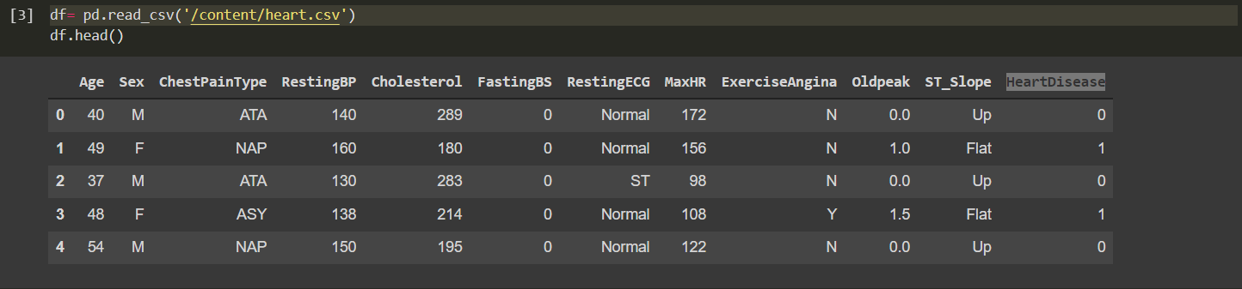
Data Information
Notes:
To start out, I just wanted to give a little background on the data set I am working with. This data is showing a few different variables that are attributed to early detection of Heart Disease. It has people with and without Heart Disease and by comparing the features we may be able to help detect Heart Disease early by screening the variable that attribute to heart disease the most.

Slide 3
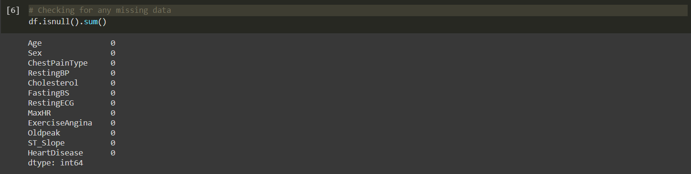
Cleaning of Data
Checked for Duplicates
Checked for any missing data or Null Values
Notes:
When starting to Explore the data I checked to see if there were any duplicates or Missing Data. I did not find any duplicates or Missing Data upon my first look. I also looked at each of Categorical and Numerical value to check for inconsistencies or Incorrect data.

Slide 4
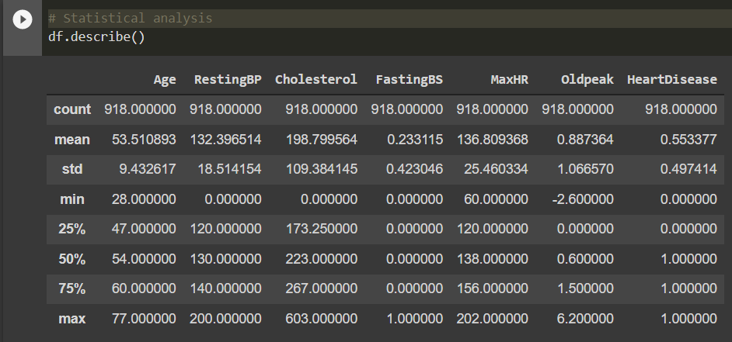

Incorrect Data
Notes:
When Looking at the Statistical analysis of the numerical data, I noticed that both RestingBP and Cholesterol both show a minimum of 0. which does not make sense. I Then looked at the Value counts of my Cholesterol Column and saw that 172 out of the 918 columns showed zero for Cholesterol. Due to this I decided to drop the column for cholesterol since a large amount is incorrect and shows 0

Slide 5
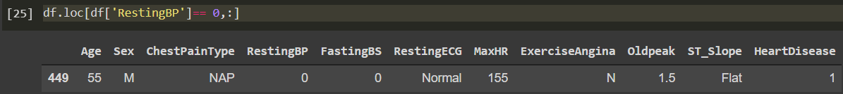
Incorrect Data
Notes:
When I looked into the data point showing zero for RestingBP I dropped this row as it was inaccurate and could cause issues with data analysis further along

Slide 6
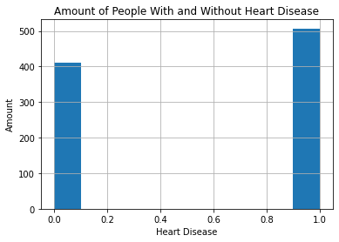
Visual of Amount of People With and Without Heart Disease in the Data Set
Notes:
This visualization shows that we have more people innour data set that have Heart disease thand People without Heart Disease. We may need to take this into consideration when we create models as the target data is slightly unbalanced

Slide 7
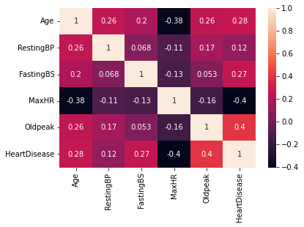
HeatMap Showing Correlations
Notes:
Lastly I made a HeatMap of the data to check for any correlation between variables. This shows that we have minimal correlation between Heart Disease and MaxHR (-.4) and HeartDeisease and OldPeak (.4). We also have a low correlation (-.38) between Age and MaxHR

